Slide 1
Section 5.2
Areas of Circles and Quadrilaterals

Slide 2
I) Review Area of a Circle:
To find the area of a circle, cut it into 8 (or more) equal pieces
Put the pieces together to create a parallelogram
The length of the top is equal to half the perimeter
The height is equal to the radius of the circle

Slide 3

II) Review #2) Area of a Trapezoid
We have two methods to prove the area of a trapezoid:
1st method is to combine two trapezoids to make a parallelogram
2nd Method is borrowed from a Chinese textbook that uses a bit of algebra. Start off with any trapezoid, left and right sides don’t need to be equal!
The two trapezoids make a parallelogram with an area of :
To find the area of a
trapezoid, divide this area by half
Cut the trapezoid into two triangles!
Factor $\frac{h}{2}$

Slide 4
Areas of Circles and Trapezoids:
In this section we will learn about finding the area of circles, trapezoids, and fractions of a circle
Here are the formulas for these shapes:
Circle
Trapezoid
¾ Circle
Parallelogram
If you are given a “composite” shape, where it’s a combination of regular shapes, cut the shape into regular polygons, get the area of each shape, and then add them up together
If you want the “proof” for the formulas of the area of a circle and trapezoid, go the end of the powerpoint

Slide 5

Areas of Composite shapes:
Composite shapes are 2D shapes created with two or more regular polygons
Below are some examples of composite shapes and how they are constructed:
When finding the area of a composite shape, you may need to “ADD” or “SUBTRACT” the areas of certain 2d shapes

Slide 6

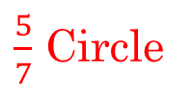
Areas of Common Composite Shapes:
These are the areas of half circles, quarter circles, or 3 quarters of a circle:
¾ Circle
½ Circle
¼ Circle
$\frac{5}{7}$ Circle
Areas of these Regular Polygons given the side lengths:
Hexagon
Pentagon
Octagon

Slide 7
Q: Find the area of the following shapes:

Slide 8
Q: Find the area of the following shapes:
This is ¾ of a Circle plus a right triangle
The circle has a radius of 4cm
The right triangle has a base and height of 4cm

Slide 9
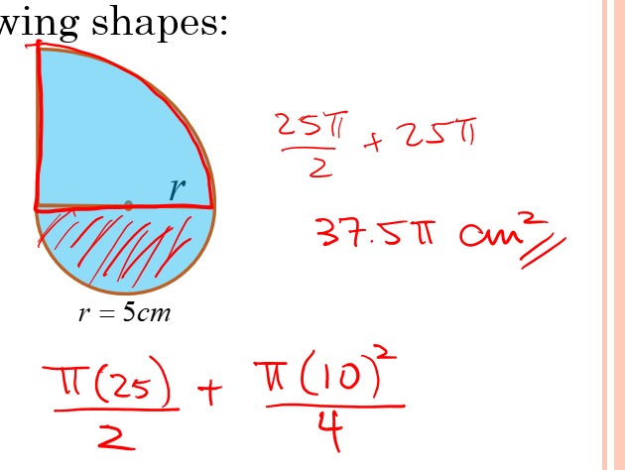

Slide 10
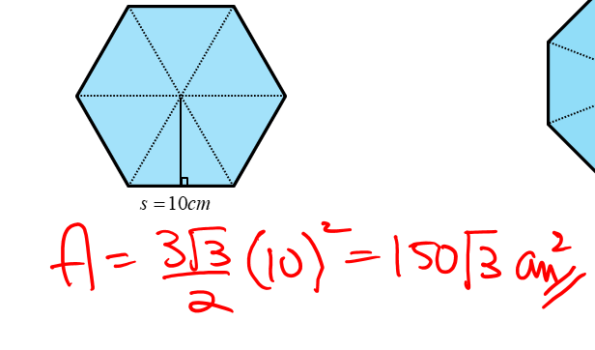

Slide 11
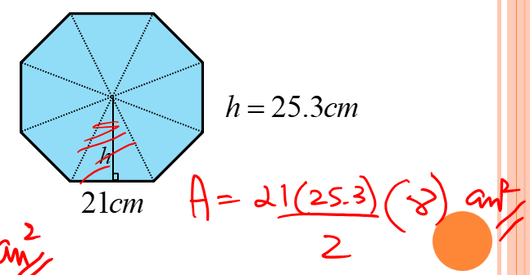

Slide 12
Practice: Find the areas of the following shapes
`

Slide 13
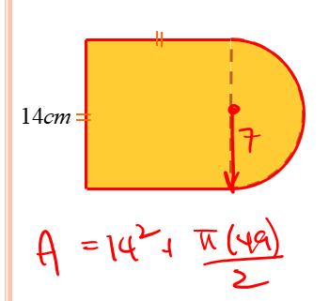
Ex: find the area & Perimeter of the solid

Slide 14
Ex: Given that the radius of a circle is 5cm, find the Area and Perimeter of half the circle.
Area
Perimeter

Slide 15
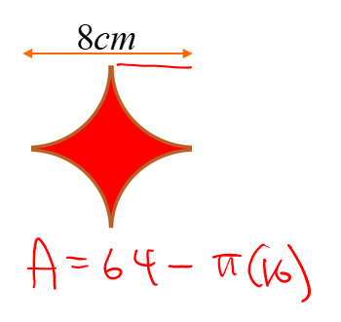

Slide 16
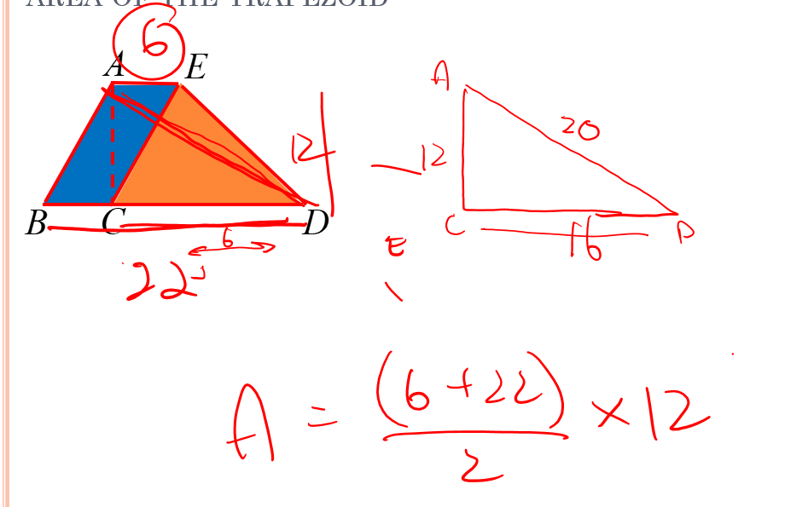
Ex: Given that AC = 12cm, AD = 20cm, AECB is a parallelogram, and the area of ΔACE = 36cm², find the area of the trapezoid

Slide 17
`

Slide 18
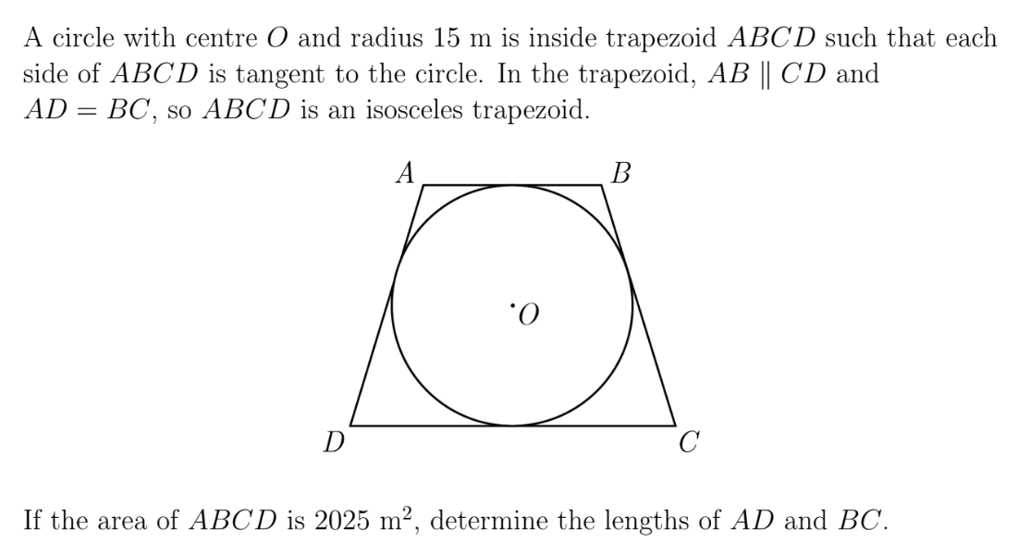

Slide 19
Ex: A circle is inscribed by two squares: One outside and one inside. If the side length of the large square is 5cm, Find the area of the red region:
Given the area of each sector in the diagram, find the area of “x”.

Slide 20
Ex: A circle is inscribed by two squares: One outside and one inside. If the side length of the large square is 5cm, Find the area of the red region:

Slide 21
Challenge:
Given the area of each sector in the diagram, find the area of “x”.

